Slide 1
Capstone Project
Customer Behavior & Retention Analytics
Capstone Project Presentation
customerData.csv
KIBIDI LERENCER| 25/03/2026
Chuka University: Center for Data Analytics and Modeling
Registration No: CDAM/0047/2026
Instructor: Lec victor Wandera

Slide 2
Objectives of the study
1.To Understand differences in customer spending and income across key groups (churn status, gender, region, marital status)
2. To Identify factors influencing customer churn to improve retention strategies.
3. To Analyze customer behavior and preferences (payment methods, online shopping) to enhance customer experience
4. To Examine relationships between demographic factors and financial behavior for better customer segmentation
5. To Provide insights to support targeted marketing and business decision-making

Slide 3
PHASE I:DATA UNDERSTANDING & CLEANING
1.Set my working directory
2. Load the libraries tidyverse, dplyr, ggplot2, psych, skimr, stringr, tidyr, reshape2, car,MASS,caret,multcomp,glmnet,Ggally,Hmisc,dunn.test,glmnet
3. Load the data set…customerData.csv from my working directory, named it ‘income’
4. Viewed the whole data set to get an understanding of what exactly it entails
15 column and 10,000 rows, 7-numerical, 8-character,

Slide 4
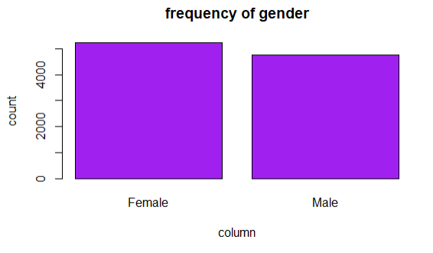
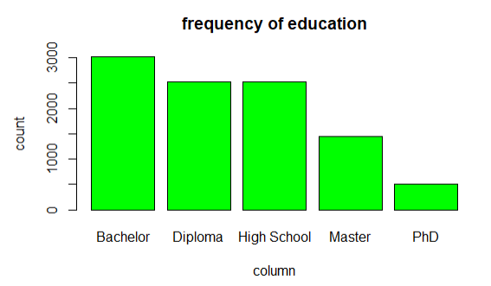
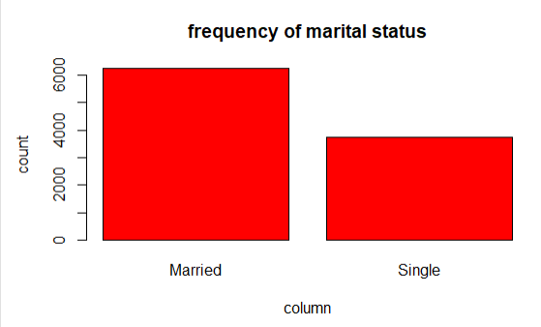
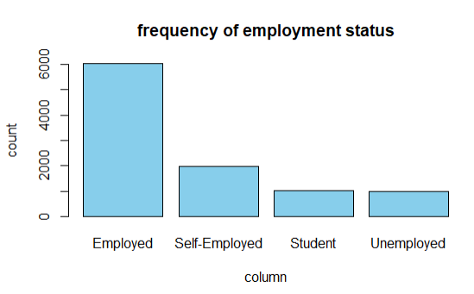
Dataset overview : categorical

Slide 5
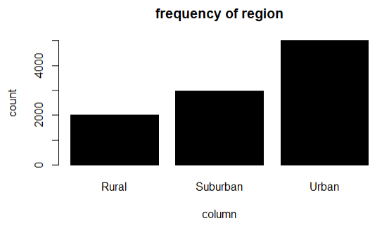
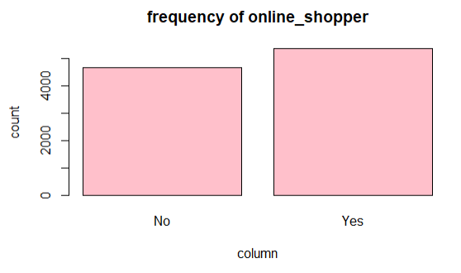
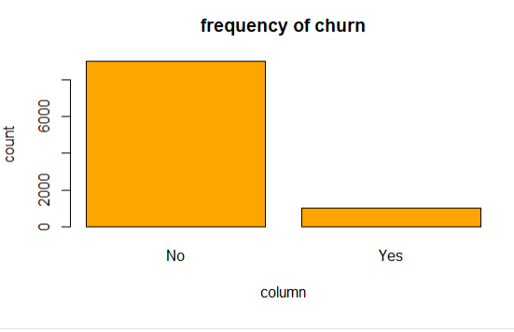
Dataset overview 2

Slide 6
Dataset overview : numerical
 | Age | Annual income | No of children | Annual spending | Credit score | loyalty years
Min | 18.00 | 5000.00 | 0.00 | 1000.00 | 300.00 | 0.00
1st Qu. | 29.00 | 26621.00 | 0.00 | 8100.00 | 420.00 | 7.00
Median | 37.00 | 42386.00 | 0.00 | 14170.00 | 460.00 | 15.00
Mean | 37.73 | 43632.00 | 1.03 | 15282.00 | 461.80 | 15.64
3RD Qu. | 46.00 | 57731.00 | 2.00 | 21134.00 | 502.00 | 23.00
Max. | 70.00 | 123315.00 | 5.00 | 59229.00 | 693.00 | 52.00

Slide 7
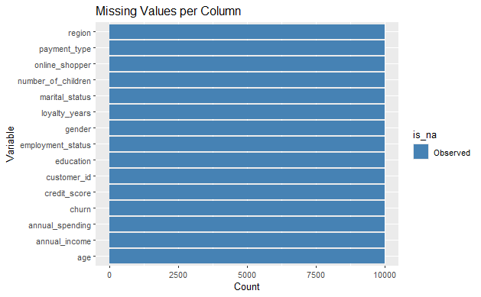
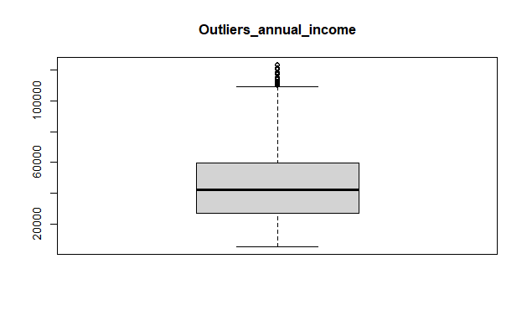
Data cleaning IV.MISSING VALUES,DUPLICATES, INCONSISTENCIES

Slide 8
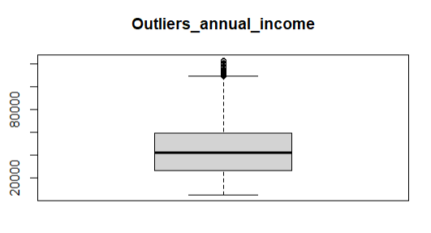
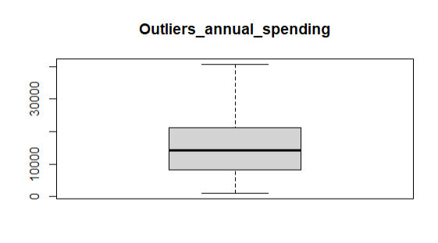
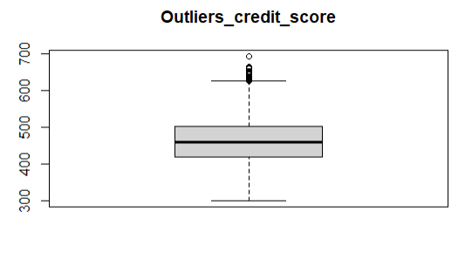
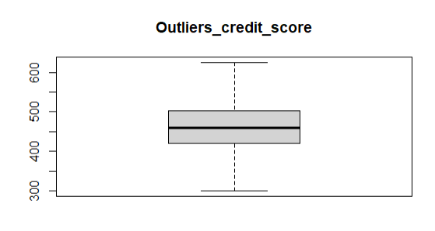
Data cleaning process:Outlier treatment
Included treating outliers I choose iqr treatment

Slide 9
DATA DICTIONARY
customer_id | customer_id | numeric | 10000
age | age | numeric | 53
gender | gender | character | 2
education | education | character | 5
employment_status | employment_status | character | 4
annual_income | annual_income | numeric | 9541
marital_status | marital_status | character | 2
number_of_children | number_of_children | numeric | 6
region | region | character | 3
annual_spending | annual_spending | numeric | 9544

Slide 10
Feature Engineering
i. Create: • spending_to_income_ratio • customer_tenure • financial_stability_score
pending_to_income_ratio <dbl> | customer_tenure_group <chr> | financial_stability_score <dbl> | stability_level <chr> | savings <int>
 | 0.3795802 | Long-term | 0.5469411 | Medium
 | 0.4174078 | Long-term | 0.5688464 | Medium
 | 0.1949258 | Long-term | 0.7473847 | High
 | 0.9522180 | New | 0.2658406 | Low
 | 0.6128041 | Long-term | 0.4274101 | Medium
 | 0.3072925 | Long-term | 0.5855772 | Medium
 | 0.3720135 | New | 0.5678483 | Medium
 | 0.3183051 | Mid-term | 0.4601475 | Medium
 | 0.1984183 | Long-term | 0.6432275 | Medium

Slide 11
Exploratory Data Analysis
1. % latex table generated in R 4.5.3 by xtable 1.8-8 package% Sun Mar 29 18:19:32 2026\begin{table}[ht]\centering\begin{tabular}{lrrrrrr} \hlineregion & N & Mean & SD & Median & 95% CI Lower & 95% CI Upper \\ \hlineRural & 2019 & 15180.70 & 9272.89 & 14262.03 & 14775.98 & 15585.42 \\ Suburban & 2980 & 15544.54 & 9395.60 & 14312.96 & 15207.06 & 15882.01 \\ Urban & 5001 & 15060.51 & 9407.99 & 14039.17 & 14799.71 & 15321.32 \\ \hline\end{tabular}\caption{Table 1: Annual Spending by Region} \label{tab:spending_region}\end{table}

Slide 12
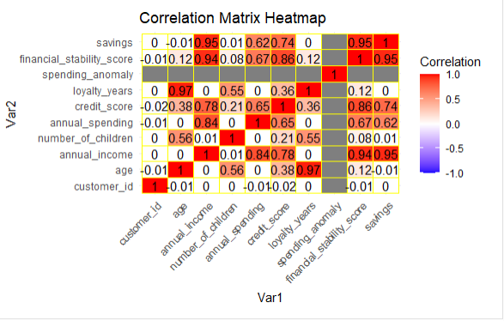
Correlation analysis

Slide 13
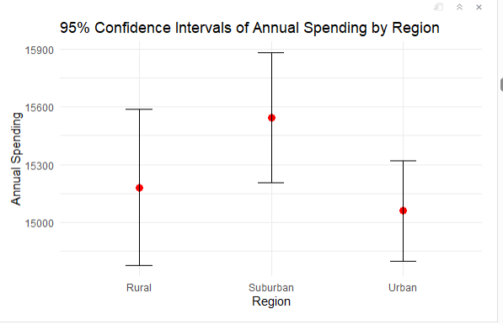
Phase 4: Descriptive Statistics & Inference
2. Confidence Intervals

Slide 14
Hypothesis Testing
H₀: All group means are equal
H₀:The variances of the groups are equal (homogeneous).
H0:The mean annual spending is equal across all regions.
H0:The distributions of annual_spending are the same for customers who churned and those who did not.
H0:The distributions of annual_spending are the same across all regions (Rural, Suburban, Urban).
H0:The distributions/median overall spending are the same across all regions (Rural, Suburban, Urban).
H0:The distribution (median) of annual spending is the same for males and females.
H0:Payment type is independent of the churn
H0:There is no difference in mean annual income between males and females.

Slide 15
H0:There is no difference in mean annual income across all education levels.
H0:There is no relationship between number of children and annual spending.
H₀: There is no difference in mean annual income between customers with children and those without.
H₀: The proportion of single females with children = proportion of single males with children
H₀: Churn is independent of employment status-There is no association between being unemployed and churning.
H₀ : Online shopping is independent of gender
H₀ :credit score is independent of education level
HO: Marital status of females is independent on Educational level
HO: Marital status of males is independent on Educational level
H0:Payment type is independent on Age
HO mean annual income of married customers is equal to those of single customers
HO mean annual spending of married customers is equal to those of single customers
H0:the mean number of children of customers across the region is equal
H0:The payment type is independent on the level of education

Slide 16
Phase 6: Regression Modeling
Simple Linear Regression: Income Explains 70% of Spending
Title: Simple Linear Regression: Income is the Key Driver
Key points:
Model: annual_spending = 551 + 0.336 × annual_income
R² = 70.1% → income alone explains 70% of variation in spending
For every $10,000 increase in income, spending rises by $3,364
The relationship is highly significant (p < 0.001)
Plot to display:
Scatter plot of annual_spending vs annual_income with the fitted regression line. Optionally, add a loess smooth to confirm linearity.

Slide 17
Regression Modeling
Multiple Regression: No Improvement Beyond Income-Simpler is Better
Added 9 variables (credit score, loyalty, age, region, employment, online shopper) → R² increased by only 0.0002 (negligible)
LASSO regression automatically dropped 8 variables; only annual_income and online_shopper remained
online_shopper added only $42.54 to predicted spending, a very small effect
Model comparison: All complex models have similar predictive power but use many extra predictors (violates parsimony)
For predicting annual spending, the simple model using only annual income is the best choice – it is accurate, interpretable, and avoids unnecessary complexity.”

Slide 18
Customer Data Insights & Business Actions
1. Education
Higher education → prefer credit/debit cards Action: Promote card-based loyalty programs and premium offers to educated customers.
Income rises with education level Action: Target high-income, highly-educated customers with premium products and upselling opportunities.
Higher education → higher credit scores Action: Segment by credit score to offer financing options and rewards; target reliable high-credit-score customers.
Education level does not predict marital status (for males or females) Action: Avoid using education to assume marital patterns; focus on income and spending behavior instead.

Slide 19
2. Spending & Churn
Customers who did not churn spend more annually than churners Action: Identify low-spending customers as at-risk; provide targeted promotions or engagement campaigns.
Payment type is not associated with churn Action: Focus retention strategies on spending behavior, engagement, and employment status rather than payment method.
Number of children does not affect annual spending Action: Avoid segmenting offers based solely on family size; focus on actual spending patterns.
Annual spending is roughly similar across regions Action: Regional campaigns can be uniform; prioritize high-potential customers instead.

Slide 20
3. Employment & Churn
Unemployed customers are more likely to churn
Action: Offer flexible payment options or value-based promotions to retain unemployed or financially vulnerable customers.
4. Income & Credit
Gender does not significantly influence spending, income, or online shopping
Action: Avoid gender-based targeting; use behavioral and demographic factors instead.
Marital status does not affect spending or income
Action: Target offers based on behavior, income, and education rather than marital status.
5. Payment Behavior
Age does not influence payment method choice
Action: Offer all payment methods universally; don’t assume older customers prefer cash.

Slide 21
conclusion
Focus retention efforts on low-spending and unemployed customers.
Highly-educated, high-income customers are key for upselling and loyalty programs.
Behavioral patterns matter more than gender, marital status, region, or age for targeting campaigns.
Use data-driven segmentation based on spending, education, and credit scores to reduce churn and increase revenue.

